Slide 1
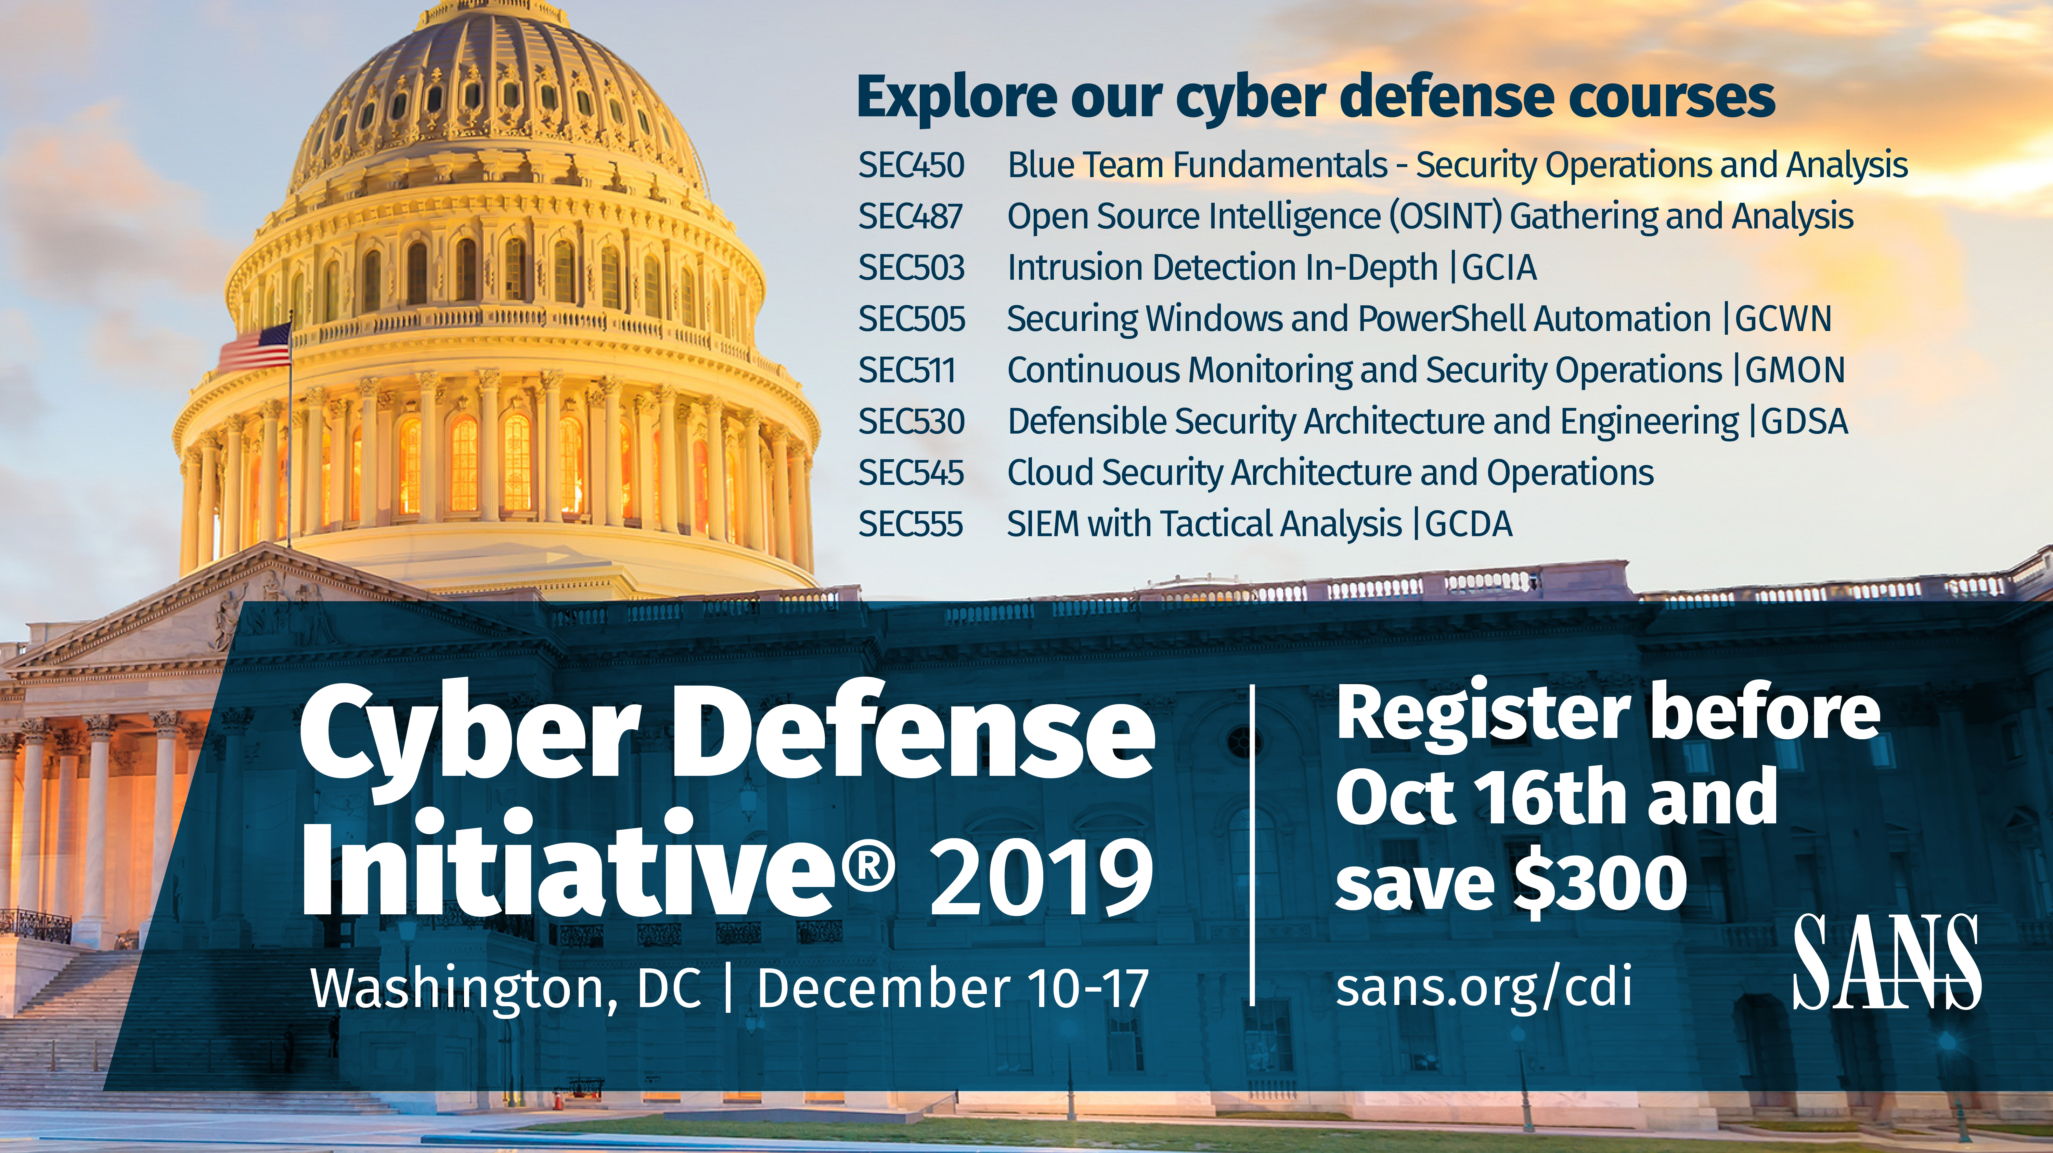

Slide 2
Getting the Most out of Your SIEM
Untapped Potential
Justin Henderson (GSE # 108) and John Hubbard
@SecurityMapper @SecHubb

Slide 3


About Us
Justin Henderson
Author - SEC555
Co-Author - SEC455, SEC530
GSE #108 / Cyber Guardian Blue + Red / 61 certs
Owner of H & A Security Solutions
Twitter: @SecurityMapper
John Hubbard
Author - SEC450
New course! Blue Team Fundamentals – Security Operations & Analysis
Co-author SEC455 , Instructor - SEC555 / SEC511
Owner of Blueprint Cyber Security
Twitter: @SecHubb

Slide 4
Welcome!
A copy of this talk is available at: https://github.com/HASecuritySolutions/presentations
More free stuff: https://github.com/HASecuritySolutions

Slide 5
Untapped Potential
Writing without vowels may still be understandable
But it is widely inefficient. Same true for SOC/SIEM
A - Automation
E - Enrichment
I - Identify
O - Orchestration
U - Universalize
Which are all enabled by Y ---> You

Slide 6

A is for
Automation

Slide 7
NXLog AutoConfig
Created to overcome log agent deficiencies and as a functional proof of concept:
https://github.com/SMAPPER/NXLog-AutoConfig
Checks systems each day looking for components (IIS, etc.)
If found, automatically configures for consistency
Or initial configuration…
Then, sets up an agent to start shipping logs
Largest deployment maintained > 12 K systems

Slide 8
Custom Logging with PowerShell
PowerShell makes writing custom logs easy!
Create new log sources
Push logs to custom Windows event channel
Example: Want to log Autoruns items?
PS > New-EventLog -LogName "My-Autoruns" -Source "Autoruns"
PS > autorunsc.exe –c > autoruns_out.csv
PS > $items = Import-Csv -Header "Time","Entry Location","Entry","Enabled","Category","Profile","Description","Company","Image Path","Version","Launch String" .\autoruns_out.csv
PS > $items | ForEach-Object {Write-EventLog -LogName "my-autoruns" -source "Autoruns" -EventId 1 -EntryType Information -Message $_}
Premade script from Palantir: http://sec450.com/autorunstoevt

Slide 9
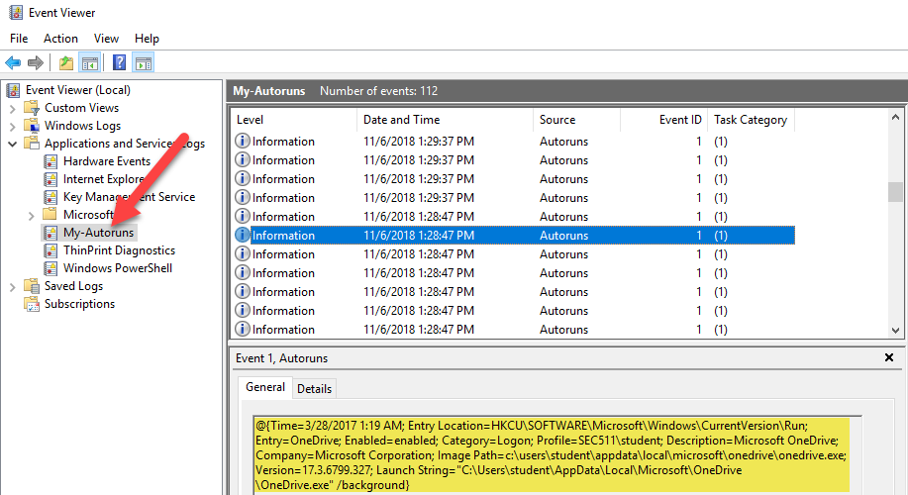
Autoruns in Windows Event Log

Slide 10
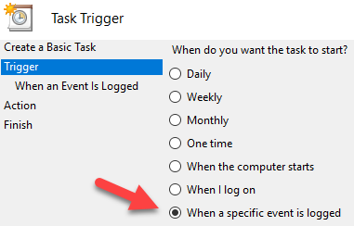
Make a New Log
What if a log lacks context... ? Build a better one
Windows Task Scheduler + PowerShell
Reads native block log
Runs custom checks against blocked binary
(Optional) Sends binary to sandbox
Generates new Windows log
Possible to use new log within SIEM:
Auto update GPO and notify user

Slide 11
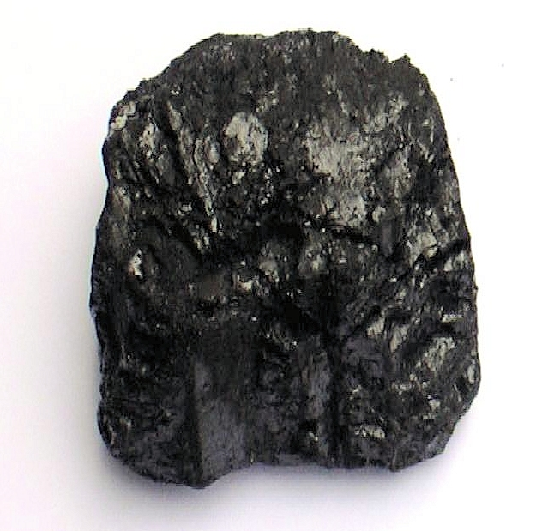

E is for…
Enrichment

Slide 12
Enrichment Example
Which would you rather investigate?
IDS Alert # 1
or
IDS Alert # 2
#1
Signature: ET POLICY PE EXE or DLL Windows file download
SID: 2000419
Classification: Potential Corporate Privacy Violation
Source IP: 74.125.159.56
Source Port: 80
Destination IP: 192.168.2.40
#2
Signature: ET POLICY PE EXE or DLL Windows file download
SID: 2000419
Classification: Potential Corporate Privacy Violation
Source IP: 74.125.159.56
Source Port: 80
Destination IP: 192.168.2.40
Geo: US
ASN: Google Inc.
DNS: dl.google.com
Process: iexplore.exe
User: jhenderson
File: ChromeSetup.exe

Slide 13
Domain Parsing
Simple breakdown of fields can yield MANY detection opportunities!
http://myaccount.google.com-securitysettingspage.tk
Subdomain field Parent domain field TLD
Lots of opportunity for detection!

Slide 14
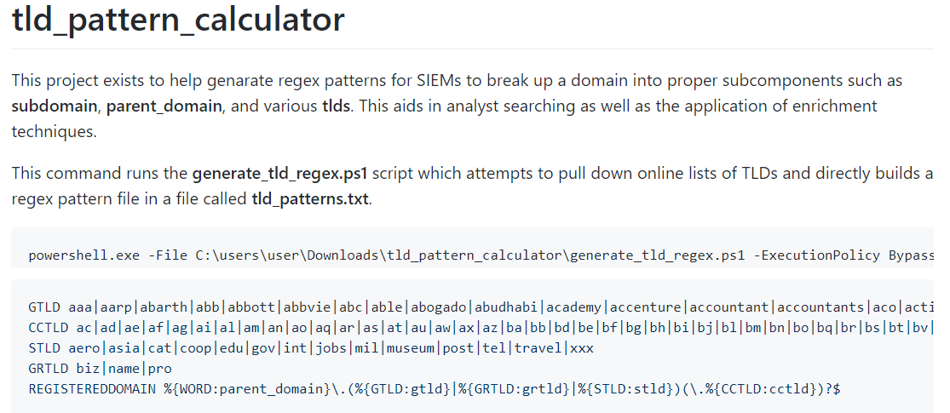
github.com/HASecuritySolutions/tld_pattern_calculator

Slide 15

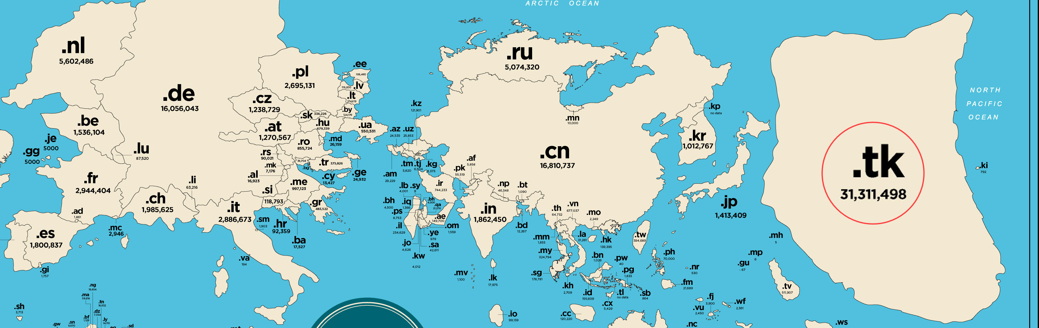
Detection Based on TLD
Some TLDs are just more evil….dashboard it!
https://www.nominet.uk/mapping-the-online-world/
Notes:
Move to identify?

Slide 16
Detection Based on Subdomain
Subdomain field:
Does it contain the word Google, or your org name?
Long / random, changing and NOT a CDN?
1000's of different subdomains per parent? Tunneling!
Phishing alert pseudo-logic examples:
If subdomain = *google*, parent domain != google.com
If subdomain contains google, ASN != Google
Group by parent domain, if unique subdomains > 500

Slide 17



Spear Phishing Link
Email Body: Check out this client’s site before our call
Links To: http://afecrej6h7cn5sdfhvjg9evmj.com
Attacker Web Server

Slide 18
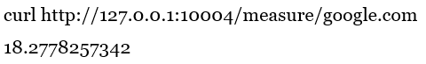
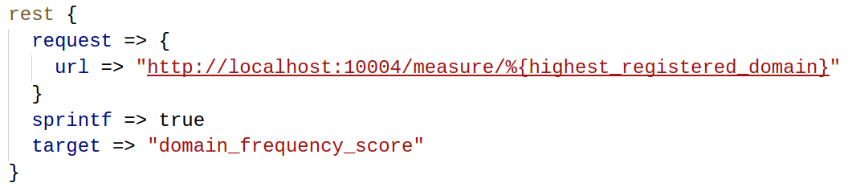
freq_server.py
How about natural language processing of select fields?
Scores the likelihood something is "weird"
Manual testing
Logstash query

Slide 19

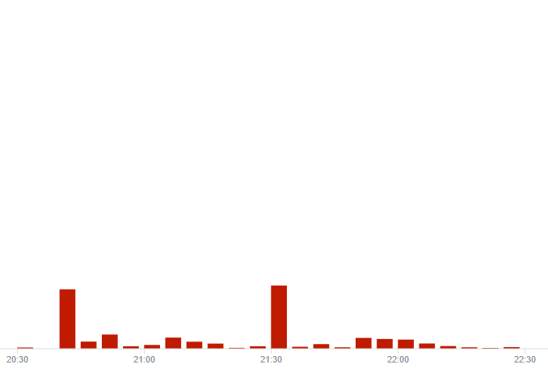
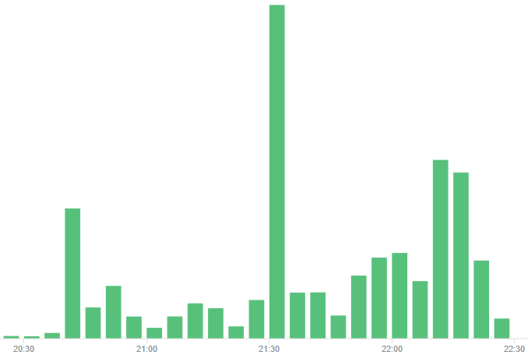
Top1M Filtering
Before
After - approx < 90% logs

Slide 20
Enrichment via SIEM auto-correlation
Does 74.125.159.56 exist in prior DNS logs (answer field)
Pull back DNS query (dl.google.com)
Any logs that have network socket to process/user?
Sysmon event ID 3 (pulls in jhenderson and iexplore.exe)
Signature: Something bad happened
SID: 2000419
Classification: Potential Corporate Privacy Violation
Source IP: 74.125.159.56
Source Port: 80
Destination IP: 192.168.2.40

Slide 21
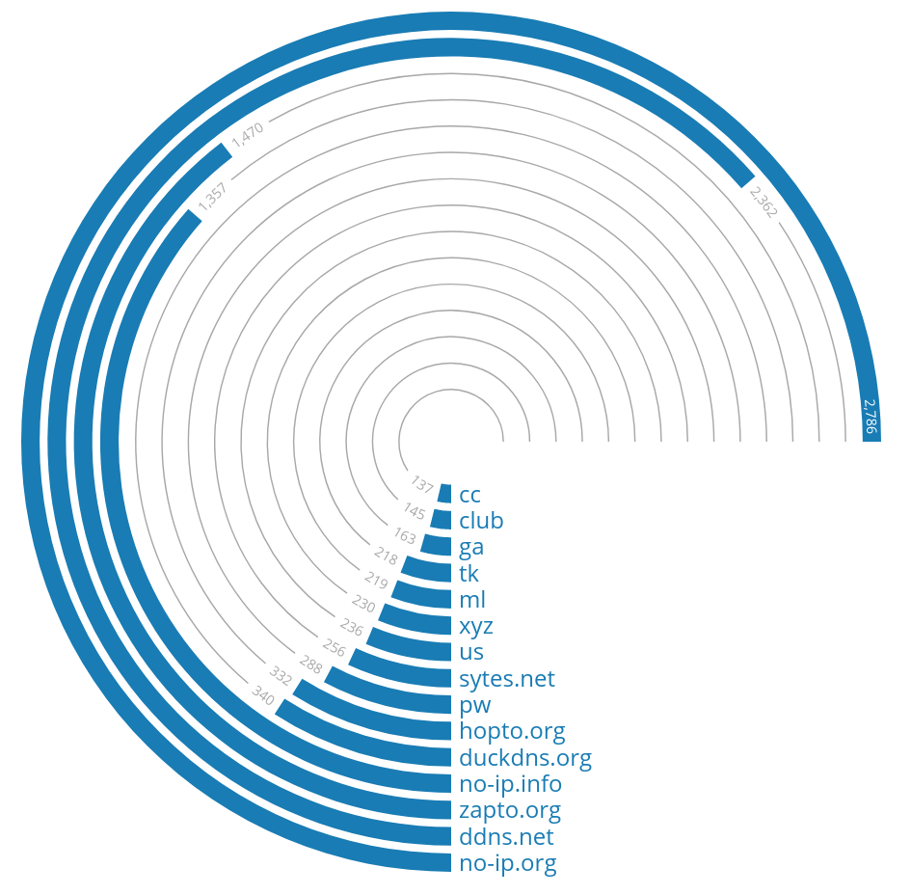
Dynamic DNS Domains
Dynamic DNS Services
VERY often used for malware
VERY unlikely to be legitimate business site
Often used for policy violation
Detect via blacklist!
Or just block access via DNS RPZ block based on nameserver*
https://medium.com/alphasoc/a-deeper-look-at-dangerous-tlds-19f9e3e77926

Slide 22

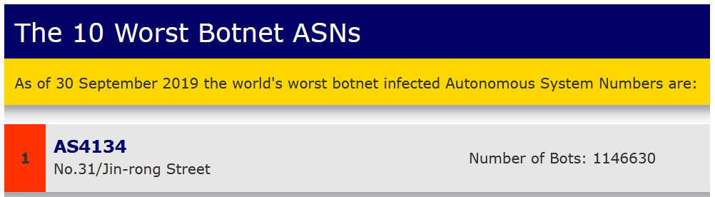
Autonomous System Numbers (ASN)
Attaches an organization name to an IP address
Makes geolocation data better
Gives context on downloads
Use case: Which is more suspicious?
User downloads file chromesetup.exe from ASN…
Google LLC
No.31/Jin-rong Street

Slide 23
I is for
Identify

Slide 24

Identify All the Things
Easy right? What do you look for?

Slide 25
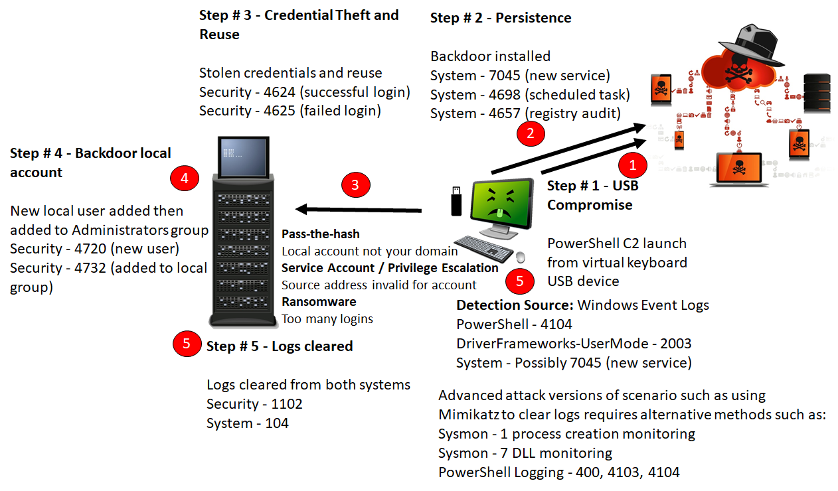
One Good Rule
Notes:
One Good Rule
This slide represents the fundamentals of security monitoring with a SIEM. The example given is a compromise via a USB drive, which then starts a persistent backdoor shell to an adversary. From there, the attacker steals credentials and pivots to additional boxes. Once on the other systems, backdoor accounts are created to simply access. Finally, the attacker’s end goal is achieved, and logs are cleared to hide any evidence the attacker was present.
In this scenario, there are multiple methods to detect each and every step the attacker takes. A digital trail is paved, and if an organization has a single rule that would identify these steps before the adversary moved too deep into the environment, then the organization would win. The problem is that SIEM’s do not natively have custom rules that work with the minimal effort out of the box. The problem is twofold: Someone has to know what to look for, and then the SIEM needs to be told how to do the looking.

Slide 26

MITRE ATT&CK¹
Adversarial Tactics, Techniques, and Common Knowledge
Focus is on actionable detection techniques
Given common adversarial methodologies
Framework is high-level enough to report on and adapt
Yet specific enough to provide actual items to look for
Source of specific detection rules
Notes:
MITRE ATT&CK¹
One source for identifying what to look for is the MITRE ATT&CK framework¹. This framework is an actionable framework based on attacker methodologies. The framework dives deep into attacker actions and presents information on how to prevent and detect adversary actions.
The main trick to MITRE is constantly monitoring for changes and then figuring out how to implement new detection rules within a SIEM solution.
[1] https://attack.mitre.org, https://sec555.com/8d

Slide 27
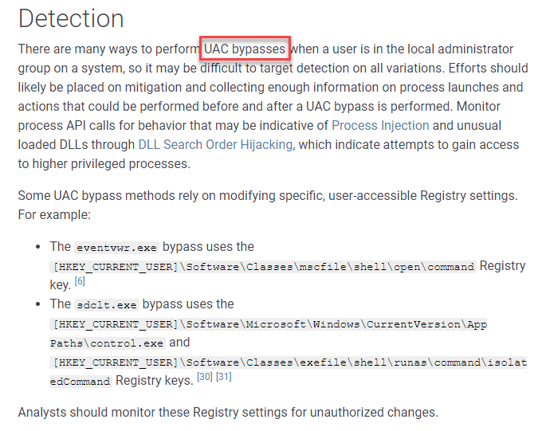
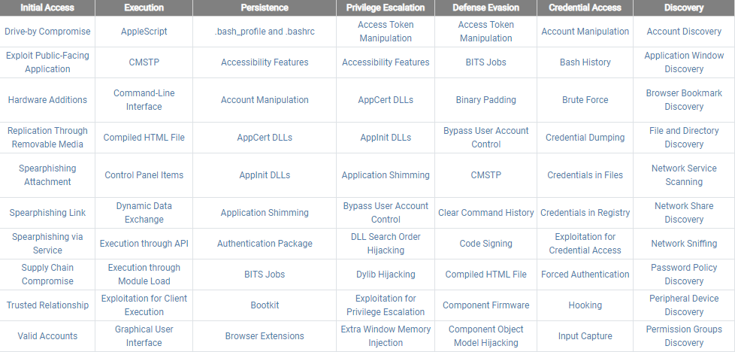
MITRE ATT&CK Matrix
Notes:
MITRE ATT&CK Matrix
This slide represents the MITRE ATT&CK Matrix and how each category provides specific objectives for creating detection rules. The framework is actionable as it provides detailed information on potential methods of detection as well as information on known attack vectors or malware related to a given category.

Slide 28
Other Repositories
More sources than just MITRE ATT&CK for detection rules
PDF - NSA Spotting the Adversary
Sigma - Open source rule repository (more on this later)
SOC Prime - Threat Detection Marketplace
Open source rules
And commercial rules
Threat Feeds - MISP, Open Threat Exchange, etc.

Slide 29

O is for…
Orchestration

Slide 30

SOAR + SIEM + SOC = Magic
SOAR
SIEM
Incident Management System
Playbook Actions
Alerts
Threat Info
Threat Intelligence Platform

Slide 31

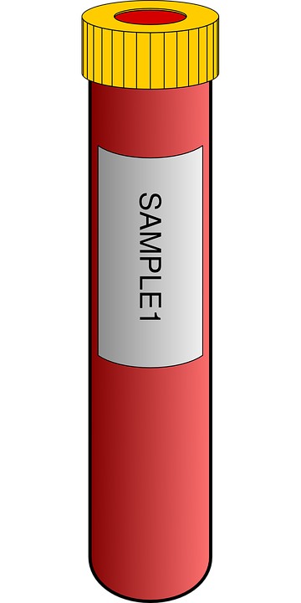

Automation and Orchestration Use Case Categories
Typical categories for SOAR:
Enumeration and Enrichment (IP, Hostname, Hash)
Using internal tool APIs
On external data
Resolved by SOAR framework
Incident Response
Blocking actions
Sample gathering
Cleanup
Alert and Case management

Slide 32











Orchestration
Receive Alert Rule
Manually Review / Assess
Convert Alert Rule
Test Alert Rule
result
sigmac
Move into Production
Notes:
Orchestration
This slide represents a possible automated quality review and orchestration for implementing shared rules. The steps would be automated with a script and perform as follows:
Pull shared rule from MISP
Convert Sigma rule with sigmac to a SIEM-specific format
Test rule outside alert engine by seeing if it would match on existing data
If matches are found, move to a location for manual assessment and open a ticket. Otherwise, validate performance and, if good, move alert into production.
The process above is an example of how rule validation and sharing can be validated and could have any number of logical evaluations.

Slide 33


Give Your SIEM a Hand with SOAR
+ Enrichment & Formatting
+ Enrichment & Formatting
SIEM
Triage / Incident Management
Logs
Alerts
SOAR
SOAR
EDR
Threat Intel Platforms
Vuln. Scan Database
Firewall
Active Directory

Slide 34

U is for…
Universalize

Slide 35
Universalize
Logs vary from data source to data source and org to org
Need to universalize for applied logic and analytics
Oct 5 15:06:54 server sshd[2014]: Failed password for invalid user 123 from 212.129.35.106 port 43271 ssh2
An account failed to log on.
Subject: Security ID: S-1-5-21-2635542286-2942777934-2742232658-1105 Account Name: jhenderson Account Domain: SEC555
How to universalize?
Parse with standard field names
Add field aliases to standard field names
Utilize tags such as logon_failure
Compare

Slide 36





Sigma
Written by Florian Roth & Thomas Patzke
"To logs, what Snort is to network traffic and YARA is to files"
High level generic language for analytics
Enables analytics re-use and sharing across orgs

Slide 37
Conversion of Signatures to Alert Queries
Sigma Rule
Splunk
Company 1 field names
Company 2 field names
Qradar
Grep command
Elasticsearch
…
Grep
Search Query
Search Query
Company 3 field names
Search Query
…
Alert Engine
Alert Engine
Analytics
Alert Engine
Written by community
Mapping to your field names, written by you

Slide 38
One Input – Three Outputs
$ ./sigmac --target splunk --config ./config/splunk-windows-index.yml win_pass_the_hash.yml
(index="windows" (LogonType="3" LogonProcessName="NtLmSsp" WorkstationName="%Workstations%" ComputerName="%Workstations%" (EventCode="4624" OR EventCode="4625")) NOT (AccountName="ANONYMOUS LOGON"))
$ ./sigmac --target qradar --config ./config/qradar.yml win_pass_the_hash.yml
SELECT UTF8(payload) as search_payload from events where (LOGSOURCETYPENAME(devicetype)='Microsoft Windows Security Event Log' and (LogonType='3' and LogonProcessName='NtLmSsp' and WorkstationName='%Workstations%' and ComputerName='%Workstations%' and ("Event ID Code"='4624' or "Event ID Code"='4625')) and not (AccountName='ANONYMOUS LOGON'))
$ ./sigmac --target es-qs --config ./config/winlogbeat.yml win_pass_the_hash.yml
(winlog.channel:"Security" AND (winlog.event_data.LogonType:"3" AND winlog.event_data.LogonProcessName:"NtLmSsp" AND winlog.event_data.WorkstationName:"%Workstations%" AND winlog.ComputerName:"%Workstations%" AND (winlog.event_id:"4624" OR winlog.event_id:"4625")) AND (NOT (winlog.event_data.AccountName:"ANONYMOUS\ LOGON")))

Slide 39
Sigma + MISP
MISP is one of the best, free Threat Intel Platforms
Wide usage in enterprise
Integrates well with other tools via open API
“Event” driven data organization
All hashes, IPs, URLs, for incident go into an "event"
Meant for sharing
Supports Sigma rules as object type
Tool sigma2misp pushes rules to events

Slide 40




Imagine a world…
Where intelligence reports come with Sigma rules
Don't have to write the analytics
Don't even have to transcribe them
They came to you through MISP!
Analytics automatically appear in Threat Intel Platform
Already associated with threat actors
Supporting IOCs included
Simply convert the rules you want!

Slide 41
Conclusion
Is your SIEM doing everything for you that it can?
Remember…
A - Automation
E - Enrichment
I - Identify
O - Orchestration
U - Universalize
Which are all enabled by Y ---> You

